Slide 1
Neural Networks

Slide 2
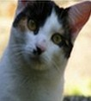
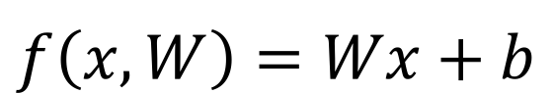
Example: linear classification of an image (cat/dog/ship)
$$f\left(x,W\right)=Wx+b$$
3 different class scores
[32x32x3]
array of numbers 0...1

Slide 3
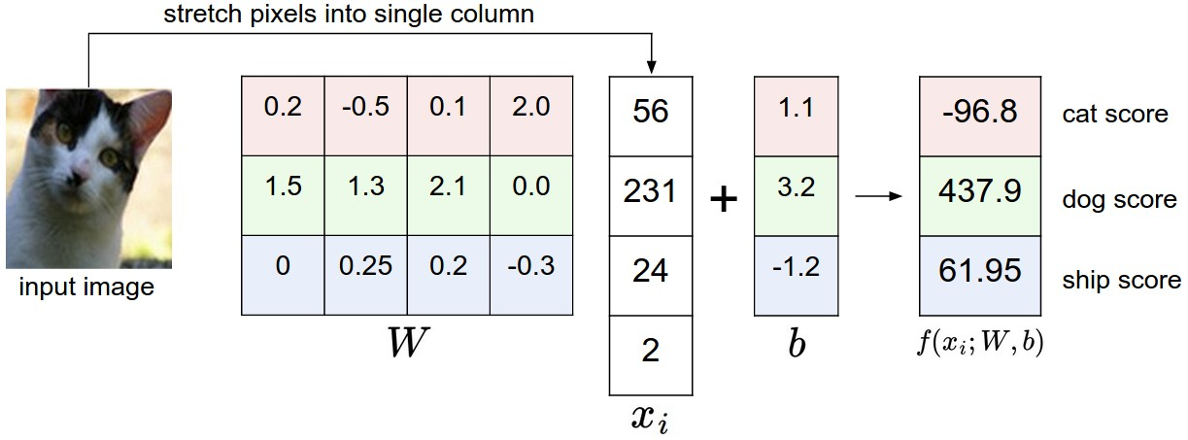
Example: linear classification of an image (cat/dog/ship)
How to learn W and b?

Slide 4
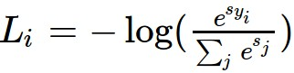
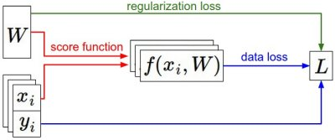

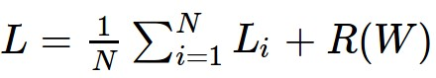
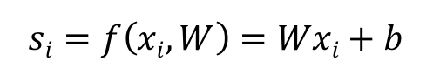
We have a dataset of (x,y)
We have a score function:
We define a loss function:
$$si=f\left(xi,W\right)=Wxi+b$$
Softmax
SVM
Total Loss+Regularization

Slide 5
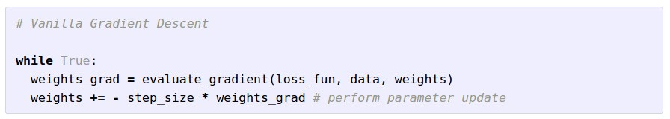
Gradient Descent

Slide 6
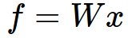
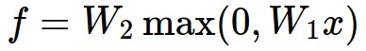
Neural Network
(Before) Linear score function:
(Now) 2-layer Neural Network
x
h
W1
W2
s
3072
100
10

Slide 7


“3-layer Neural Net”, or
“2-hidden-layer Neural Net”
“2-layer Neural Net”, or
“1-hidden-layer Neural Net”
“Fully-connected” layers

Slide 8

vector describing various image statistics
f
Feature Extraction
3 numbers, indicating class scores
training
[32x32x3]
f
3 numbers, indicating class scores
training
[32x32x3]

Slide 9


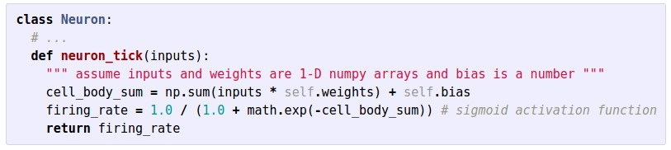

Slide 10
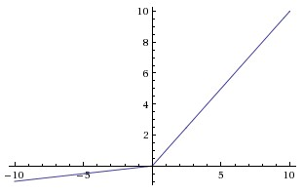
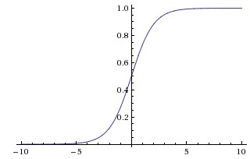
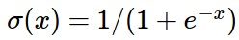
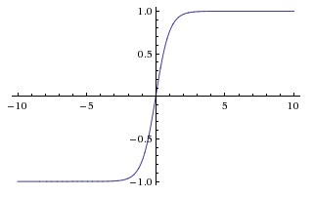
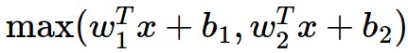
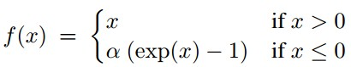
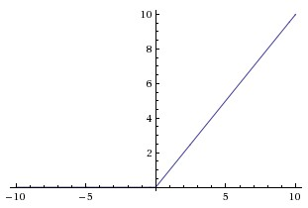
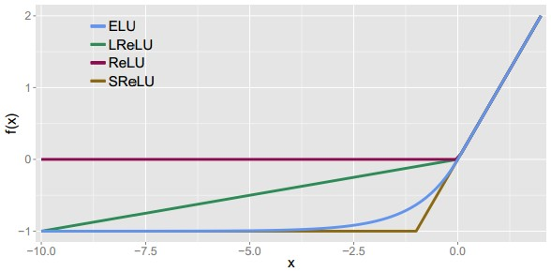
Activation Functions
Leaky ReLU
max(0.1x, x)
Sigmoid
Maxout
tanh tanh(x)
ELU
ReLU max(0,x)

Slide 11
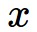
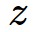
activations
f

Slide 12
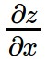
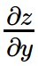
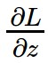
activations
f
“local gradient”
gradients

Slide 13
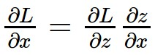
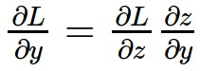
activations
f
“local gradient”
gradients

Slide 14
activations
f
“local gradient”
gradients

Slide 15
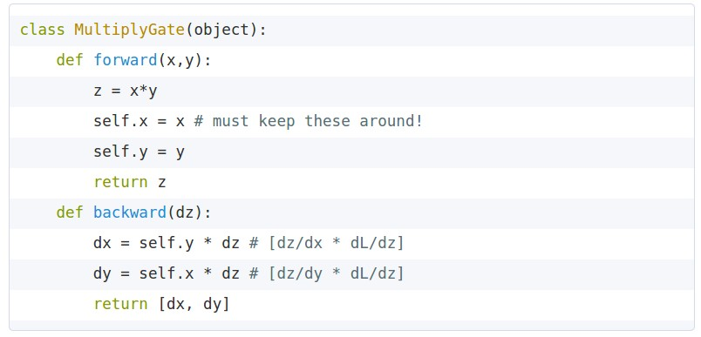
Implementation
x
z
*
y

Slide 16
Optimization -
Parameter Updates

Slide 17
Minibatch Stochastic Gradient Descent
Loop:
Sample a batch of data
Forward prop it through the graph, get loss
Backprop to calculate the gradients
Update the parameters using the gradient

Slide 18
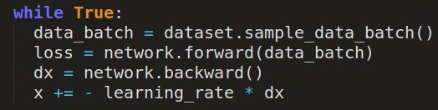
simple gradient descent update

Slide 19
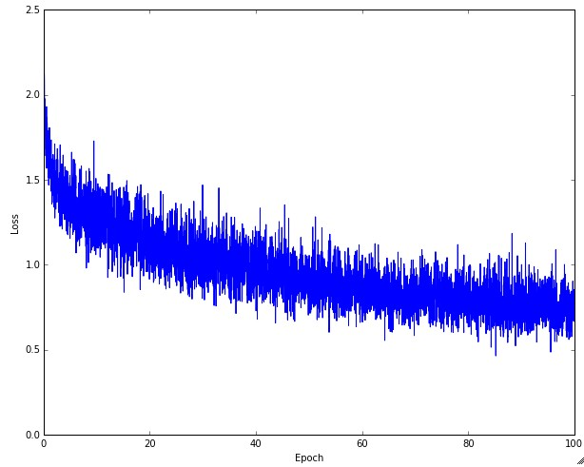
Example of optimization progress while training a neural network.
(Loss over mini-batches goes down over time.)

Slide 20
Suppose loss function is steep vertically but shallow horizontally:
Q: What is the trajectory along which we converge towards the minimum with SGD?

Slide 21
Q: What is the trajectory along which we converge towards the minimum with SGD?

Slide 22
Q: What is the trajectory along which we converge towards the minimum with SGD?

Slide 23
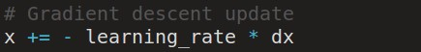
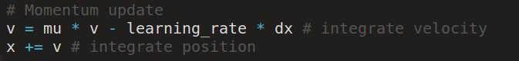
Momentum update
momentum
step
actual step
gradient
step
Allows a velocity to “build up” along shallow directions
Velocity becomes damped in steep direction due to quickly changing sign

Slide 24
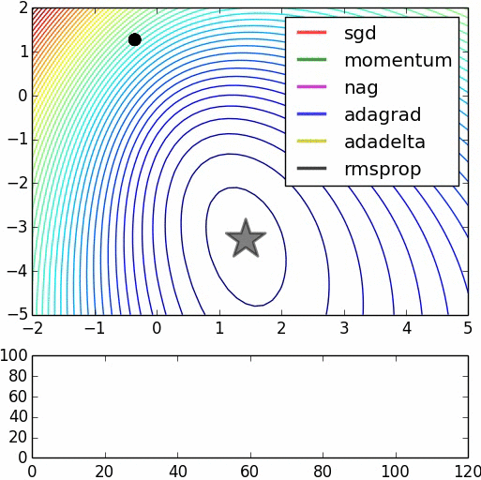

Slide 25

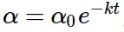
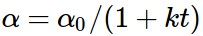
Learning rate is still a hyperparameter
=> Learning rate decay over time!
step decay:
e.g. decay learning rate by half every few epochs.
exponential decay:
1/t decay:

Slide 26
Regularization of NN (dropout)

Slide 27
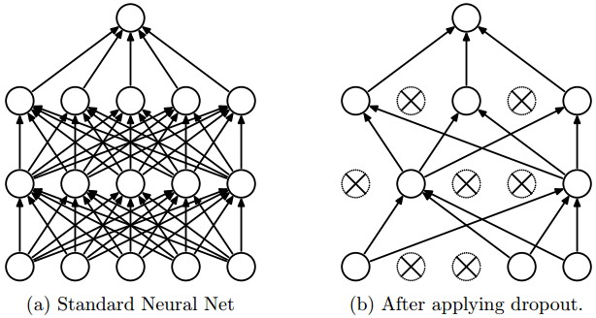
Regularization: Dropout
“randomly set some neurons to zero in the forward pass”
[Srivastava et al., 2014]

Slide 28
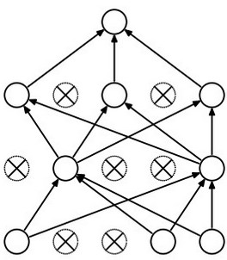
Forces the network to have a redundant representation.
has an ear
X
has a tail
is furry
X
cat
score
has claws
X
mischievous
look

Slide 29
Convolutional Neural Networks

Slide 30
Convolution Layer
32x32x3 image
32
height
32
width
3
depth

Slide 31
Convolution Layer
32x32x3 image
5x5x3 filter
32
Convolve the filter with the image
i.e. “slide over the image spatially, computing dot products”
32
3

Slide 32

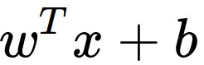
Convolution Layer
32x32x3 image
5x5x3 filter
32
1 number:
the result of taking a dot product between the filter and a small 5x5x3 chunk of the image
(i.e. 5*5*3 = 75-dimensional dot product + bias)
32
3

Slide 33
Convolution Layer
activation map
32x32x3 image
5x5x3 filter
32
28
convolve (slide) over all spatial locations
32
28
3
1

Slide 34
A closer look at spatial dimensions:
7
7x7 input (spatially)
assume 3x3 filter
7

Slide 35
A closer look at spatial dimensions:
7
7x7 input (spatially)
assume 3x3 filter
7

Slide 36
A closer look at spatial dimensions:
7
7x7 input (spatially)
assume 3x3 filter
7

Slide 37
A closer look at spatial dimensions:
7
7x7 input (spatially)
assume 3x3 filter
7

Slide 38
A closer look at spatial dimensions:
7
7x7 input (spatially)
assume 3x3 filter
=> 5x5 output
7

Slide 39
In practice: Common to zero pad the border
0 | 0 | 0 | 0 | 0 | 0
0
0
0
0
e.g. input 7x7
3x3 filter, applied with stride 1
pad with 1 pixel border => what is the output?
7x7 output!
in general, common to see CONV layers with stride 1, filters of size FxF, and zero-padding with (F-1)/2. (will preserve size spatially)
e.g. F = 3 => zero pad with 1
F = 5 => zero pad with 2
F = 7 => zero pad with 3

Slide 40
consider a second, green filter
Convolution Layer
32x32x3 image
5x5x3 filter
activation maps
32
28
convolve (slide) over all spatial locations
32
28
3
1

Slide 41
For example, if we had 6 5x5 filters, we’ll get 6 separate activation maps:
activation maps
32
28
Convolution Layer
32
28
3
6
We stack these up to get a “new image” of size 28x28x6!

Slide 42
The brain/neuron view of CONV Layer
32
E.g. with 5 filters,
CONV layer consists of neurons arranged in a 3D grid
(28x28x5)
There will be 5 different neurons all looking at the same region in the input volume
28
32
28
3
5

Slide 43

Pooling layer
makes the representations smaller and more manageable
operates over each activation map independently:

Slide 44
MAX POOLING
Single depth slice
1 | 1 | 2 | 4
5 | 6 | 7 | 8
3 | 2 | 1 | 0
1 | 2 | 3 | 4
x
max pool with 2x2 filters and stride 2
6 | 8
3 | 4
y

Slide 45
ConvNet is a sequence of Convolutional Layers, interspersed with activation functions
32
28
CONV,
ReLU
e.g. 6 5x5x3 filters
32
28
3
6

Slide 46
ConvNet is a sequence of Convolutional Layers, interspersed with activation functions
32
28
24
….
CONV,
ReLU
e.g. 6 5x5x3 filters
CONV,
ReLU
e.g. 10 5x5x6 filters
CONV,
ReLU
32
28
24
3
6
10

Slide 47

Fully Connected Layer (FC layer): Contains neurons that connect to the entire input volume, as in ordinary Neural Networks

Slide 48

Case Study: LeNet-5
[LeCun et al., 1998]
Conv filters were 5x5, applied at stride 1
Subsampling (Pooling) layers were 2x2 applied at stride 2
i.e. architecture is [CONV-POOL-CONV-POOL-CONV-FC]

Slide 49
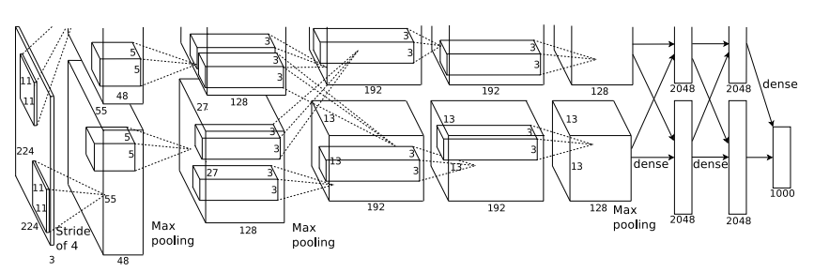
Case Study: AlexNet
[Krizhevsky et al. 2012]
Full (simplified) AlexNet architecture:
[227x227x3] INPUT
[55x55x96] CONV1: 96 11x11 filters at stride 4, pad 0
[27x27x96] MAX POOL1: 3x3 filters at stride 2
[27x27x96] NORM1: Normalization layer
[27x27x256] CONV2: 256 5x5 filters at stride 1, pad 2
[13x13x256] MAX POOL2: 3x3 filters at stride 2
[13x13x256] NORM2: Normalization layer
[13x13x384] CONV3: 384 3x3 filters at stride 1, pad 1
[13x13x384] CONV4: 384 3x3 filters at stride 1, pad 1
[13x13x256] CONV5: 256 3x3 filters at stride 1, pad 1
[6x6x256] MAX POOL3: 3x3 filters at stride 2
[4096] FC6: 4096 neurons
[4096] FC7: 4096 neurons
[1000] FC8: 1000 neurons (class scores)
Details/Retrospectives:
- first use of ReLU
- used Norm layers (not common anymore)
- heavy data augmentation
- dropout 0.5
- batch size 128
- SGD Momentum 0.9
- Learning rate 1e-2, reduced by 10
manually when val accuracy plateaus
- L2 weight decay 5e-4
- 7 CNN ensemble: 18.2% -> 15.4%

Slide 50
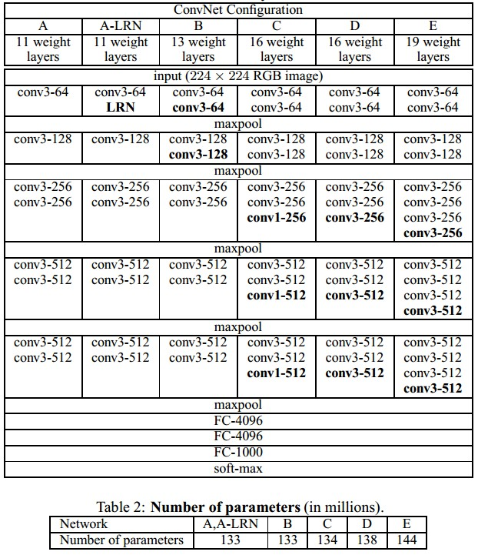
Case Study: VGGNet
[Simonyan and Zisserman, 2014]
Only 3x3 CONV stride 1, pad 1
and 2x2 MAX POOL stride 2
11.2% top 5 error in ILSVRC 2013
->
7.3% top 5 error

Slide 51
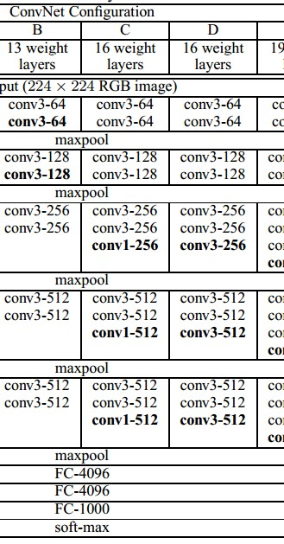
INPUT: [224x224x3] memory: 224*224*3=150K params: 0
CONV3-64: [224x224x64] memory: 224*224*64=3.2M params: (3*3*3)*64 = 1,728
CONV3-64: [224x224x64] memory: 224*224*64=3.2M params: (3*3*64)*64 = 36,864
POOL2: [112x112x64] memory: 112*112*64=800K params: 0
CONV3-128: [112x112x128] memory: 112*112*128=1.6M params: (3*3*64)*128 = 73,728
CONV3-128: [112x112x128] memory: 112*112*128=1.6M params: (3*3*128)*128 = 147,456
POOL2: [56x56x128] memory: 56*56*128=400K params: 0
CONV3-256: [56x56x256] memory: 56*56*256=800K params: (3*3*128)*256 = 294,912
CONV3-256: [56x56x256] memory: 56*56*256=800K params: (3*3*256)*256 = 589,824
CONV3-256: [56x56x256] memory: 56*56*256=800K params: (3*3*256)*256 = 589,824
POOL2: [28x28x256] memory: 28*28*256=200K params: 0
CONV3-512: [28x28x512] memory: 28*28*512=400K params: (3*3*256)*512 = 1,179,648
CONV3-512: [28x28x512] memory: 28*28*512=400K params: (3*3*512)*512 = 2,359,296
CONV3-512: [28x28x512] memory: 28*28*512=400K params: (3*3*512)*512 = 2,359,296
POOL2: [14x14x512] memory: 14*14*512=100K params: 0
CONV3-512: [14x14x512] memory: 14*14*512=100K params: (3*3*512)*512 = 2,359,296
CONV3-512: [14x14x512] memory: 14*14*512=100K params: (3*3*512)*512 = 2,359,296
CONV3-512: [14x14x512] memory: 14*14*512=100K params: (3*3*512)*512 = 2,359,296
POOL2: [7x7x512] memory: 7*7*512=25K params: 0
FC: [1x1x4096] memory: 4096 params: 7*7*512*4096 = 102,760,448
FC: [1x1x4096] memory: 4096 params: 4096*4096 = 16,777,216
FC: [1x1x1000] memory: 1000 params: 4096*1000 = 4,096,000
TOTAL memory: 24M * 4 bytes ~= 93MB / image (only forward! ~*2 for bwd)
TOTAL params: 138M parameters

Slide 52
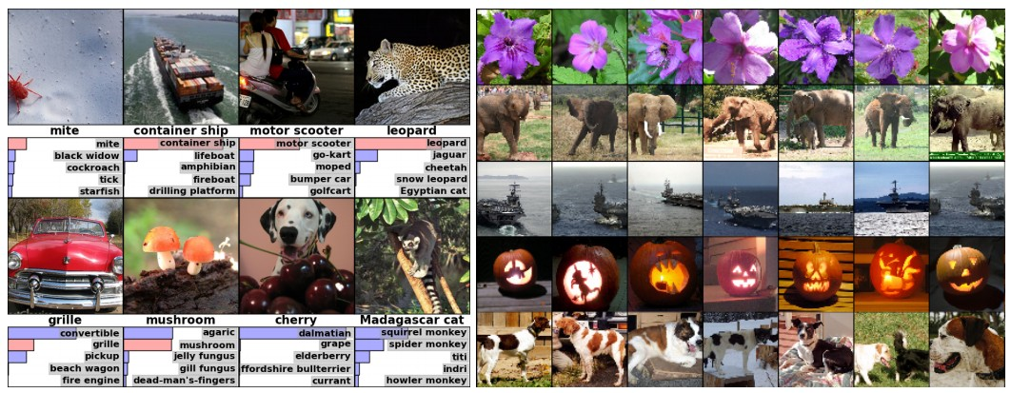
Classification
Retrieval
[Krizhevsky 2012]

Slide 53
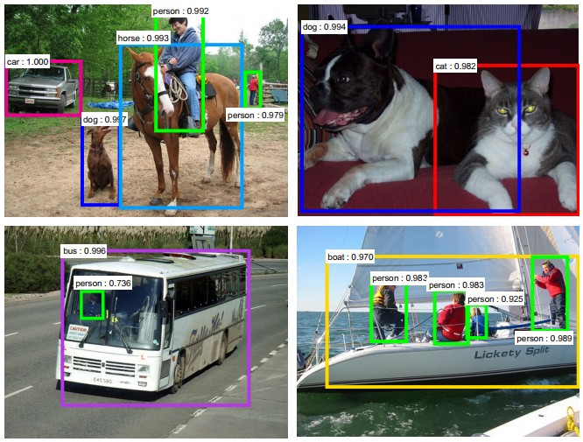
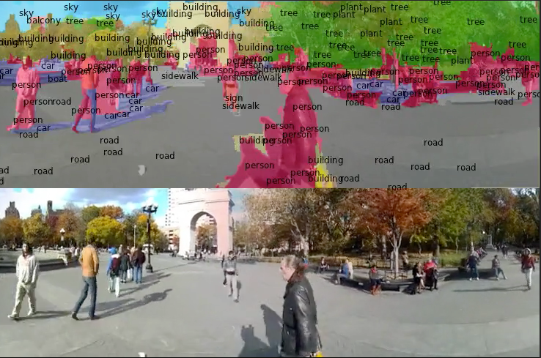
Detection
Segmentation
[Faster R-CNN: Ren, He, Girshick, Sun 2015]
[Farabet et al., 2012]

Slide 54
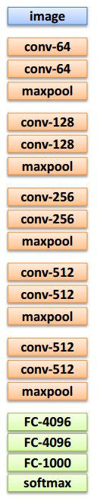
Transfer Learning with CNNs
2. Small dataset:
feature extractor
3. Medium dataset:
finetuning
more data = retrain more of the network (or all of it)
1. Train on
Imagenet
Freeze these
Freeze these
Train this
Train this

Slide 55
Unsupervised Learning

Slide 56
Supervised vs Unsupervised
Supervised Learning
Data: (x, y)
x is data, y is label
Goal: Learn a function to map x -> y
Examples: Classification, regression, object detection, semantic segmentation, image captioning, etc
Unsupervised Learning
Data: x
Just data, no labels!
Goal: Learn some structure of the data
Examples: Clustering, dimensionality reduction, feature learning, generative models, etc.

Slide 57
Unsupervised Learning
Autoencoders
Traditional: feature learning
Variational: generate samples
Generative Adversarial Networks
Generate samples

Slide 58
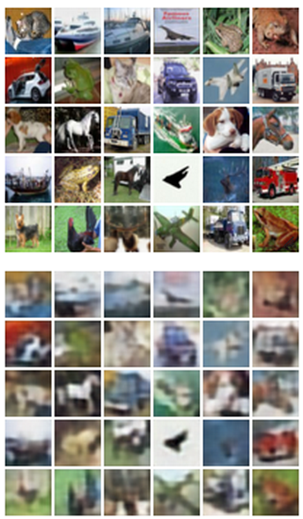
Autoencoders
Originally: Linear + nonlinearity (sigmoid)
Later: Deep, fully-connected
Later: ReLU CNN
z usually smaller than x
(dimensionality reduction)
Features
z
Encoder
Input data
x

Slide 59
Autoencoders
Originally: Linear + nonlinearity (sigmoid)
Later: Deep, fully-connected
Later: ReLU CNN (upconv)
Reconstructed input data
xx
Decoder
Encoder: 4-layer conv
Decoder: 4-layer upconv
Features
z
Encoder
Input data
x

Slide 60
Autoencoders
Reconstructed input data
xx
After training,
throw away decoder
Decoder
Features
z
Encoder
Input data
x

Slide 61
Autoencoders
Loss function (Softmax, etc)
bird
plane
Predicted Label
yy
y
dog
deer
truck
Use encoder to initialize a supervised model
Classifier
Fine-tune encoder jointly with classifier
Train for final task (sometimes with small data)
Features
z
Encoder
Input data
x

Slide 62
Autoencoders
Autoencoders can reconstruct data, and can learn features to initialize a supervised model
Can we generate images from an autoencoder?
Reconstructed input data
xx
Decoder
Features
z
Encoder
Input data
x

Slide 63
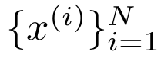
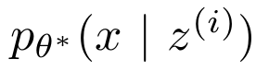
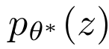
Variational Autoencoder
A Bayesian spin on an autoencoder
Assume our data is generated like this:
Intuition: x is an image, z gives class, orientation, attributes, etc
Sample from true conditional
Sample from true prior
z
x
Kingma and Welling, “Auto-Encoding Variational Bayes”, ICLR 2014

Slide 64
Variational Autoencoder
Data point
x
Kingma and Welling, ICLR 2014

Slide 65
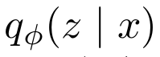
Variational Autoencoder
Mean and (diagonal) covariance of
𝜇^{z}
Σ^{z}
Encoder network
Data point
x
Kingma and Welling, ICLR 2014

Slide 66
Variational Autoencoder
z
Sample from
Mean and (diagonal) covariance of
𝜇^{z}
Σ^{z}
Encoder network
Data point
x
Kingma and Welling, ICLR 2014

Slide 67
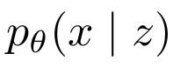
Variational Autoencoder
𝜇^{x}
Σ^{x}
Mean and (diagonal) covariance of
Decoder network
z
Sample from
Mean and (diagonal) covariance of
𝜇^{z}
Σ^{z}
Encoder network
Data point
x
Kingma and Welling, ICLR 2014

Slide 68
Variational Autoencoder
Reconstructed
xx
Sample from
𝜇^{x}
Σ^{x}
Mean and (diagonal) covariance of
Decoder network
z
Sample from
Mean and (diagonal) covariance of
𝜇^{z}
Σ^{z}
Encoder network
Data point
x
Kingma and Welling, ICLR 2014

Slide 69

Variational Autoencoder
Training like a normal autoencoder: reconstruction loss at the end, regularization toward prior in middle
Reconstructed
xx
Sample from
𝜇^{x}
Σ^{x}
Mean and (diagonal) covariance of
(should be close to data x)
Decoder network
z
Sample from
Mean and (diagonal) covariance of
(should be close
to prior )
𝜇^{z}
Σ^{z}
Encoder network
Data point
x
Kingma and Welling, ICLR 2014

Slide 70



Variational Autoencoder: Math
Latent states should follow the prior
Reconstruct
the input data
“Elbow”
Variational lower bound (elbow)
Training: Maximize lower bound

Slide 71


Variational Autoencoder: Generate Data
Diagonal prior on z => independent latent variables
After network is trained:
Generated
xx
Sample from
𝜇^{x}
Σ^{x}
Decoder
network
z
Sample from prior

Slide 72
Autoencoder Overview
Traditional Autoencoders
Try to reconstruct input
Used to learn features, initialize supervised model
Variational Autoencoders
Bayesian meets deep learning
Sample from model to generate images

Slide 73
Generative Adversarial Nets
Goodfellow et al, “Generative Adversarial Nets”, NIPS 2014
Random noise
z

Slide 74
Generative Adversarial Nets
Goodfellow et al, “Generative Adversarial Nets”, NIPS 2014
Fake image
x
Generator
Random noise
z

Slide 75
Generative Adversarial Nets
Goodfellow et al, “Generative Adversarial Nets”, NIPS 2014
Real or fake?
y
Discriminator
Fake image
x
Generator
Random noise
z

Slide 76
Generative Adversarial Nets
Goodfellow et al, “Generative Adversarial Nets”, NIPS 2014
Real or fake?
y
Discriminator
Fake image
x
x
Real image
Generator
Fake examples: from generator
Real examples: from dataset
Random noise
z

Slide 77
Generative Adversarial Nets
Goodfellow et al, “Generative Adversarial Nets”, NIPS 2014
Real or fake?
y
Train generator and discriminator jointly
After training, easy to generate images
Discriminator
Fake image
x
x
Real image
Generator
Fake examples: from generator
Real examples: from dataset
Random noise
z

Slide 78


Generative Adversarial Nets
Generated samples
Goodfellow et al, “Generative Adversarial Nets”, NIPS 2014

Slide 79

Generative Adversarial Nets
Train separate model per-class on CIFAR-10
Denton et al, NIPS 2015

Slide 80

Generative Adversarial Nets
Radford et al, ICLR 2016

Slide 81

Generative Adversarial Nets
Smiling woman
Neutral woman
Neutral man
Samples from the model
Radford et al, ICLR 2016

Slide 82

Karras et al, ICLR 2018

Slide 83

Karras et al, ICLR 2018

Slide 84

Karras et al, ICLR 2018

